Slide 1
Sampling Theorem

Slide 2
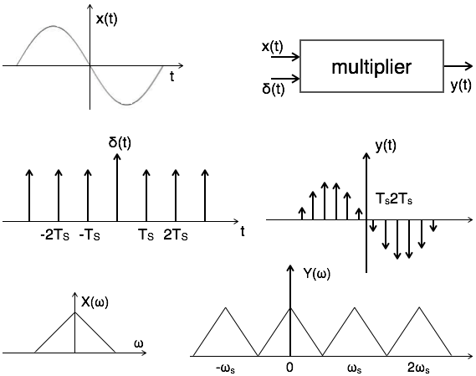

Slide 3
A continuous time signal can be represented in its samples and can be recovered back when sampling frequency f_{s} is greater than or equal to the twice the highest frequency component of message signal. i. e.
fs≥2fm.

Slide 4
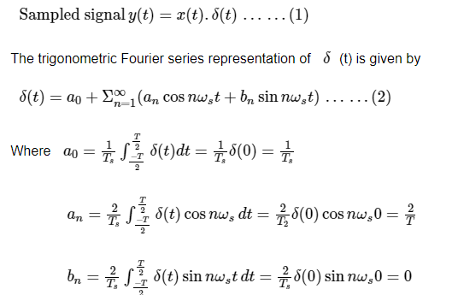
the sampled signal takes the period of impulse. The process of sampling can be explained by the following mathematical expression:

Slide 5
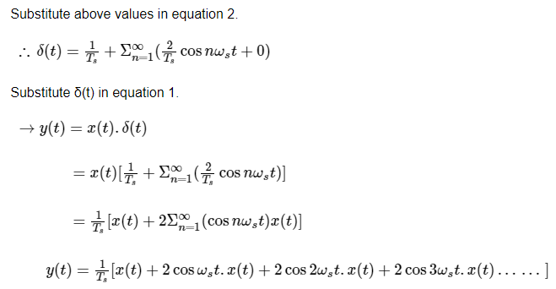

Slide 6
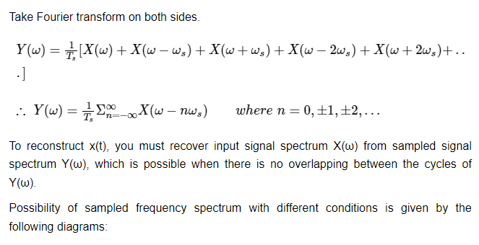

Slide 7
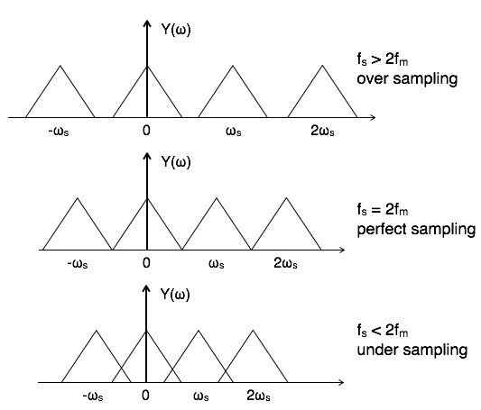

Slide 8
Aliasing Effect
The overlapped region in case of under sampling represents aliasing effect, which can be removed by
considering f_{s} >2f_{m}
By using anti aliasing filters.
There are three types of sampling techniques:
Impulse sampling.
Natural sampling.
Flat Top sampling.

Slide 9

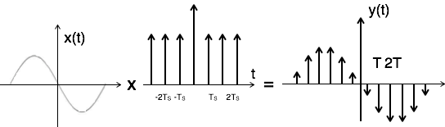
Impulse Sampling
Impulse sampling can be performed by multiplying input signal x(t) with impulse train of
period 'T'. Here, the amplitude of impulse changes with respect to amplitude of input signal x(t). The output of sampler is given by

Slide 10
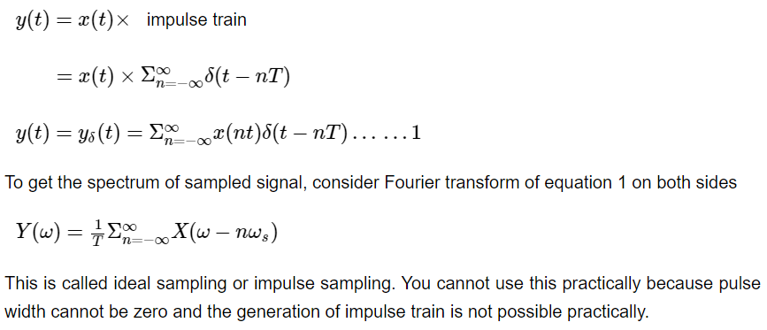

Slide 11

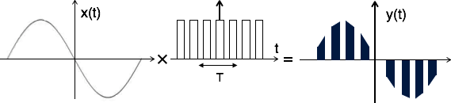
Natural Sampling
Natural sampling is similar to impulse sampling, except the impulse train is replaced by pulse train of period T. i.e. you multiply input signal x(t) to pulse train

Slide 12
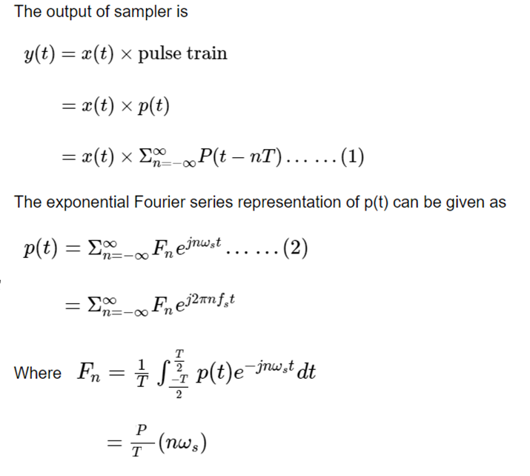

Slide 13
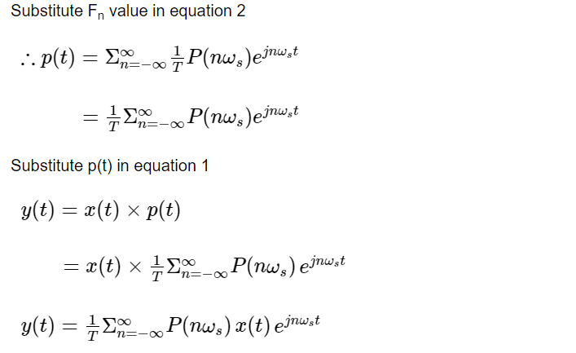

Slide 14
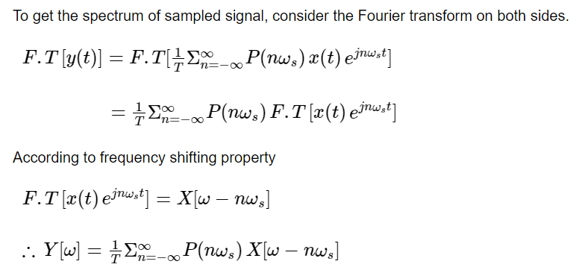

Slide 15
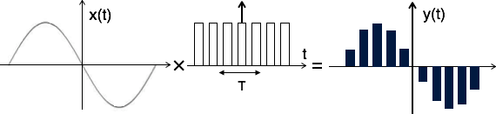

Flat Top Sampling
Theoretically, the sampled signal can be obtained by convolution of rectangular pulse p(t) with ideally sampled signal say y_{δ}(t) as shown in the diagram:

Slide 16
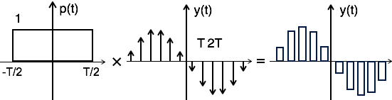
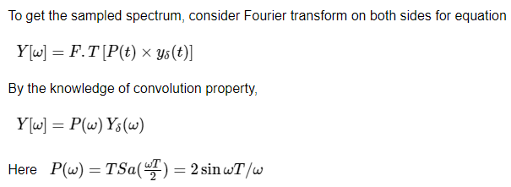

Slide 17

Nyquist Rate
It is the minimum sampling rate at which signal can be converted into samples and can be recovered back without distortion.
Nyquist rate f_{N} = 2f_{m} hz

Slide 18
Determine the Nyquist sampling rate and Nyquist sampling interval for the signal x(t)= sinc²(200 t)
The Nyquist sampling theorem states that the sampling rate should be at least twice the highest frequency component of the signal. In this case, the signal is a sinc² function with a single frequency component at 200 Hz.
The highest frequency component of the signal is 200 Hz, so the Nyquist sampling rate should be at least 2 * 200 Hz = 400 Hz.
The Nyquist sampling interval is the reciprocal of the Nyquist sampling rate, so:
Nyquist sampling interval = 1 / Nyquist sampling rate
Nyquist sampling interval = 1 / 400 Hz
Nyquist sampling interval = 0.0025 seconds or 2.5 milliseconds
Therefore, to properly sample the signal x(t)= sinc^2 (200 t), we should use a Nyquist sampling rate of at least 400 Hz and a Nyquist sampling interval of 2.5 milliseconds.

Slide 19
Aliasing is a phenomenon that occurs when a continuous-time signal is under sampled, i.e., sampled at a rate lower than the Nyquist rate (twice the maximum frequency of the signal).
The aliasing effect can be mathematically represented using the following equation:
y(t) = x(t) * p(t)
where y(t) is the sampled signal, x(t) is the original continuous-time signal, and p(t) is the impulse train used for sampling.
The Fourier transform of y(t) can be expressed as:
Y(f) = X(f) * P(f)
where * denotes the convolution operation, and P(f) is the Fourier transform of the impulse train.

Slide 20
If the sampling rate is less than the Nyquist rate, the frequency response of P(f) will have overlaps in the frequency domain, resulting in aliasing. These overlaps can be represented as:
P(f) = ∑[δ(f - kf_{s})]
where k is an integer and f_{s} is the sampling frequency.
Substituting this into the equation above, we get:
Y(f) = X(f) * ∑[δ(f - kf_{s})]
which simplifies to:
Y(f) = ∑[X(f-kf_{s})]
This shows that the Fourier transform of the sampled signal Y(f) is a periodic summation of the original signal X(f) with a period of f_{s}. The overlapping frequency components in P(f) cause the original signal to be replicated multiple times, resulting in aliasing.

Slide 21




To prove the Sampling Theorem, let's start with the sampled signal which is given by:
where p(t) is the sampling pulse, which is a periodic function with period T, and x(nT) is the value of x(t) at time t=nT.
The Fourier transform of is:
where P(f) is the Fourier transform of the sampling pulse p(t).

Slide 22



Note that the Fourier transform of a periodic function with period T is a sum of Dirac delta functions:
where f_{s}=1/T is the sampling frequency. Substituting this into the above equation, we get:
The above equation tells us that the spectrum of the sampled signal x_{s(t)} is the spectrum of the original signal X(f), replicated at multiples of the sampling frequency f_{s}. This phenomenon is known as spectral aliasing.

Slide 23
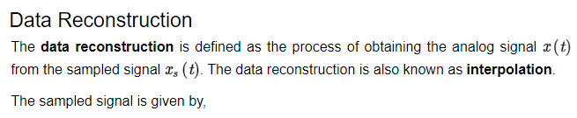




Slide 24



By rearranging the order of integration and summation, we get,

Slide 25
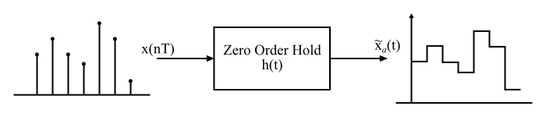
What is Zero-Order Hold?
The zero-order hold is a method which is widely used to reconstruct the signals in real time. In the zero-order hold reconstruction method, the continuous signal is reconstructed from its samples by holding the given sample for an interval until the next sample is received. Therefore, the zero-order hold generates the step approximations.

Slide 26
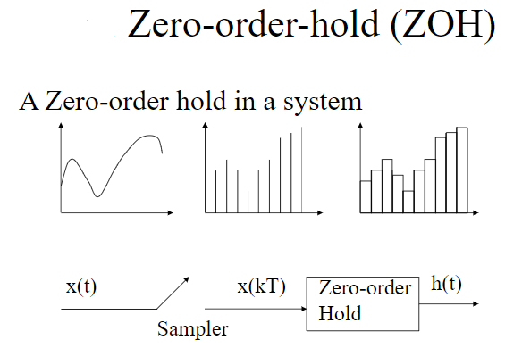

Slide 27
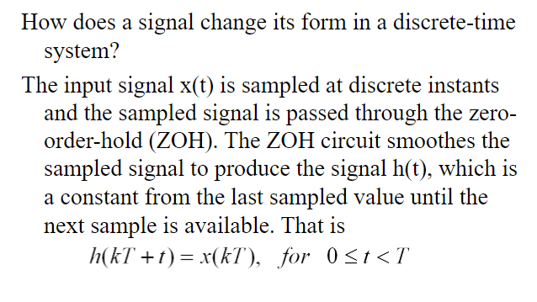

Slide 28
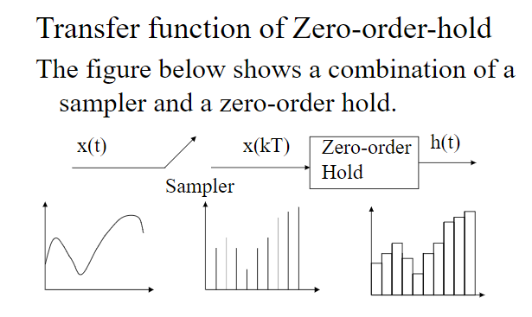

Slide 29
x~a(t)=x(n); for nT≤n≤(n+1)T
x~a(t)=x(0); for0≤t≤T
x~a(t)=x(T); forT≤t≤2T
x~a(t)=x(2T);f or2T≤t≤3T and so on
Also, the impulse response of the zero-order hold is given by,
h(t)={1 for 0≤t≤T 0 otherwise

Slide 30
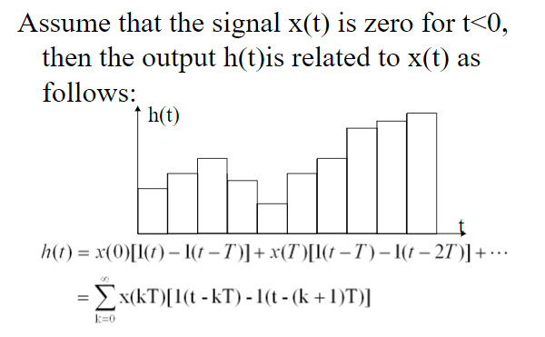

Slide 31
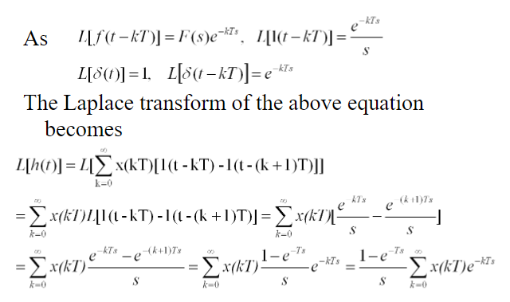

Slide 32
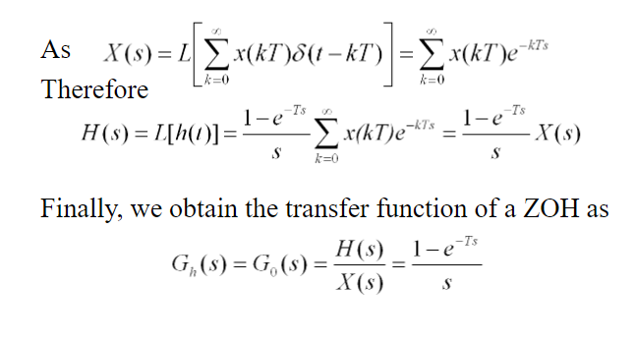

Slide 33
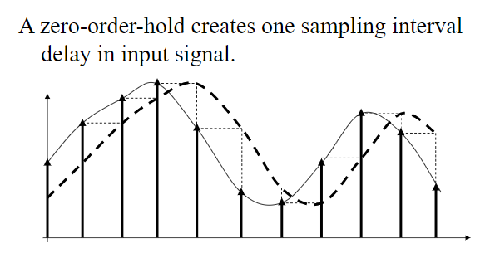

Slide 34
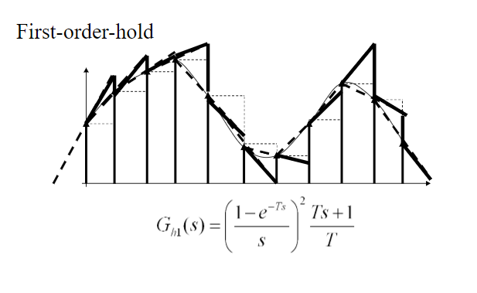

Slide 35
Interpolation refers to the process of estimating the values of a signal at intermediate points between sampled points. An ideal interpolator is a theoretical concept that provides the best possible interpolation performance by perfectly reconstructing the original signal.
The ideal interpolator is characterized by two key properties: perfect reconstruction and zero distortion. Perfect reconstruction means that the interpolated signal exactly matches the original signal at the sampled points, and zero distortion means that there is no distortion or alteration of the signal during the interpolation process.

Slide 36
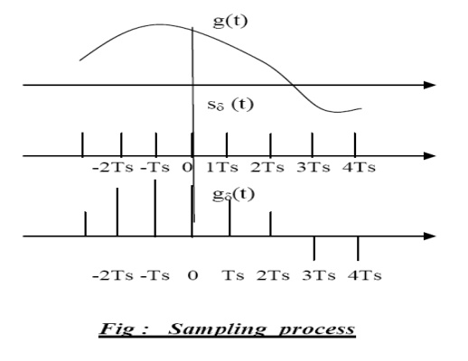
SAMPLING THEOREM FOR LOW-PASS SIGNALS:-
Statement: - “If a band –limited signal g(t) contains no frequency components for ׀f׀ > W, then it is completely described by instantaneous values g(kTs) uniformly spaced in time with period Ts ≤ 1/2W. If the sampling rate, fs is equal to the Nyquist rate or greater (fs ≥ 2W), the signal g(t) can be exactly reconstructed.

Slide 37
Part - I If a signal x(t) does not contain any frequency component beyond W Hz, then the signal is completely described by its instantaneous uniform samples with sampling interval (or period ) of Ts< 1/(2W) sec.
Part – II The signal x(t) can be accurately reconstructed (recovered) from the set of uniform instantaneous samples by passing the samples sequentially through an ideal (brick-wall) lowpass filter with bandwidth B, where W ≤ B <fs – W and fs = 1/(Ts).

Slide 38
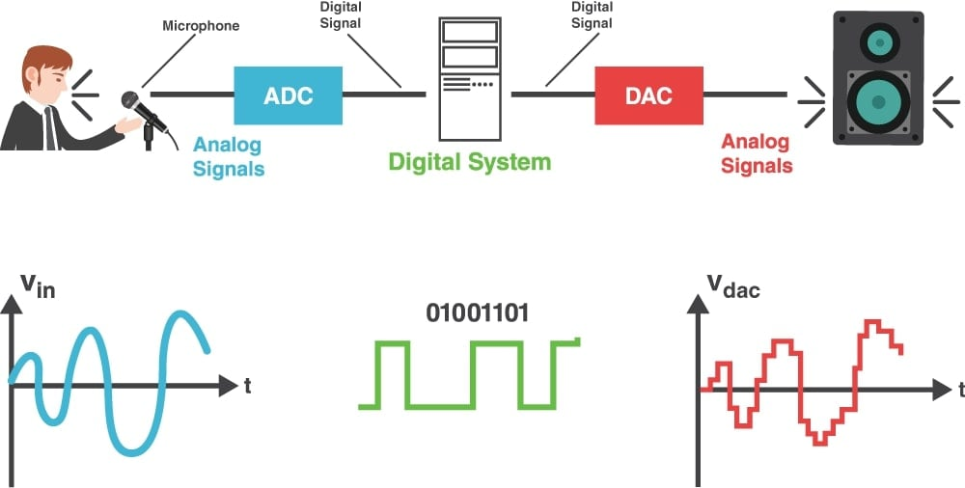

Slide 39
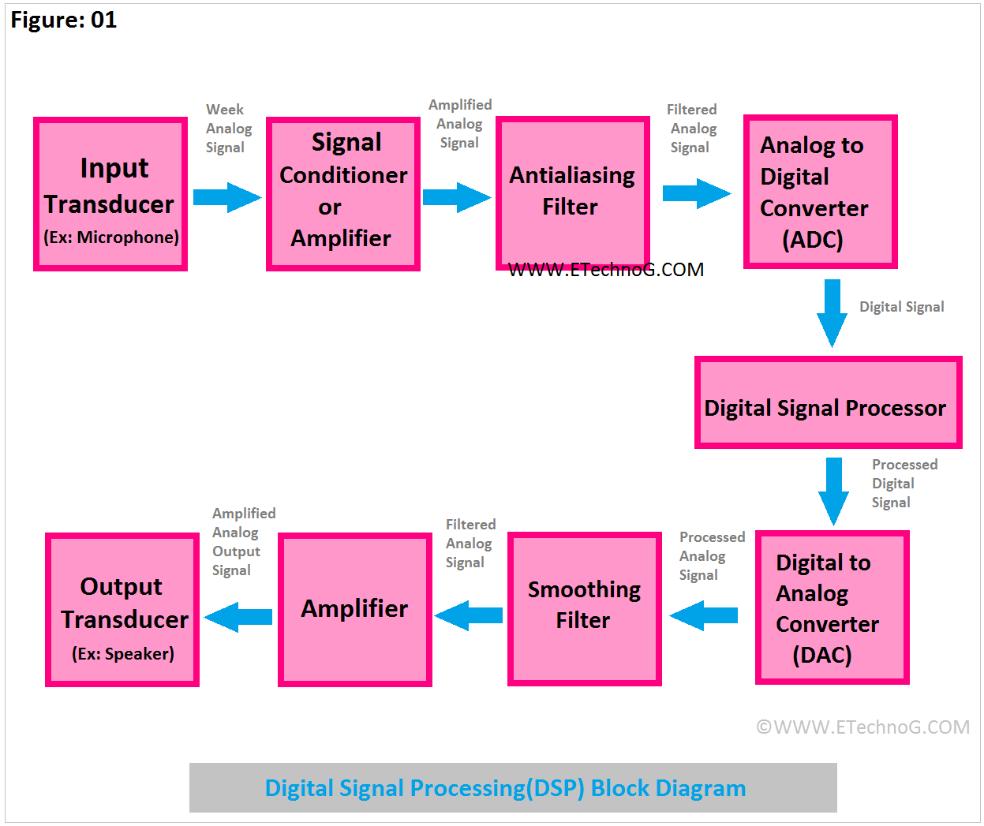

Slide 40
Digital Signal Processing converts signals from real world sources (usually in analog form) into digital data that can then be analyzed. Analysis is performed in digital form because once a signal has been reduced to numbers, its components can be isolated and manipulated in more detail than in analog form.

Slide 41



Frequency-domain representation of Sampling
The sampling process can be mathematically represented by a multiplication of the contiguous-time signal with an impulse streams.
Since the x_{s}(t) is obtained by multiplying x_{c}(t) with s(t) its Frequency spectrum X_{s}( w ) can be obtained by convolving X_{c}( w ) and S( w ) , which are frequency spectrum of x_{c}(t) and s(t) , respectively.
the Fourier transform of a periodic impulse stream becomes another periodic impulse stream in the frequency domain.
Therefore, the spectrum of the sampled signal can be obtained by superposing the replicated spectra of the continuous-time signal after shifting with the amount of k w_{s} , respectively.

Slide 42
sampling – creating a discrete signal from a continuous process.
downsampling (decimation) – subsampling a discrete signal
upsampling – introducing zeros between samples to create a longer Signal
aliasing – when sampling or downsampling, two signals have same sampled representation but differ between sample locations.

Slide 43
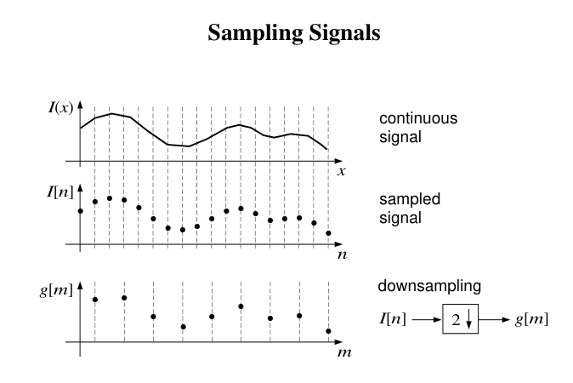
What is meant by upsampling?
Upsampling is the process of inserting zero-valued samples between original samples to increase the sampling rate. (This is sometimes called “zero-stuffing”.) This kind of upsampling adds undesired spectral images to the original signal, which are centered on multiples of the original sampling rate

Slide 44
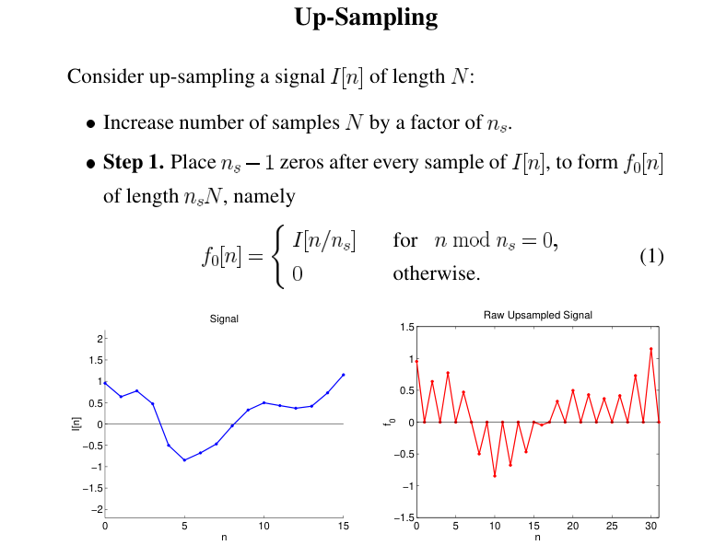

Slide 45
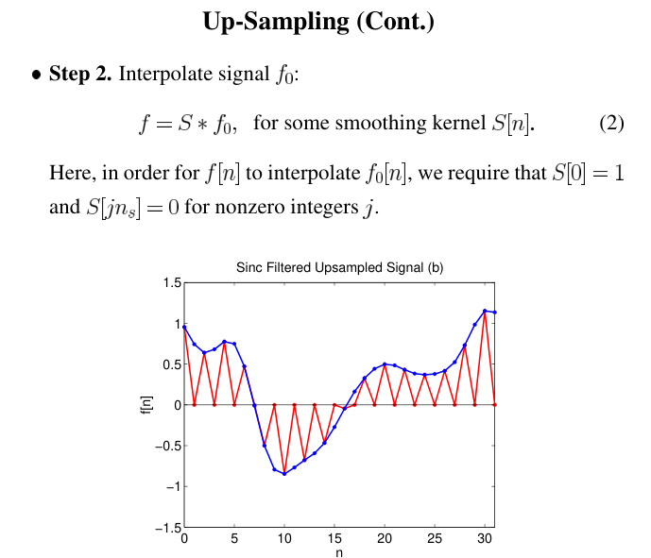

Slide 46
Reconstruction of a Band-limited signal using ideal low pass filter.
Sampling: The continuous band-limited signal is sampled at a rate greater than or equal to the Nyquist rate, which is twice the maximum frequency component of the signal. The sampling is done to convert the continuous signal into a discrete-time signal.
Filtering: The discrete-time signal is passed through an ideal low-pass filter, which allows only the frequency components within the bandwidth of the signal to pass through and attenuates all the other frequency components to zero.
Interpolation: The output of the ideal low-pass filter is an approximation of the original signal, which is also a discrete-time signal. To reconstruct the original signal, the approximation is interpolated to create a continuous signal.
Upsampling: The interpolated signal is then upsampled by inserting zeros between the samples. This step increases the sampling rate of the signal, making it more accurate and closer to the original continuous signal.
Filtering: The upsampled signal is passed through another ideal low-pass filter, which removes any frequency components beyond the original bandwidth of the signal. This filter ensures that the reconstructed signal is free from any aliasing distortion.
Final reconstruction: The output of the second filter is a reconstructed signal, which is a continuous signal that is an approximation of the original band-limited signal.

Slide 47
Let x(t) be a continuous-time band-limited signal with bandwidth B Hz.
Sampling: The continuous signal is sampled at a rate of Fs samples per second, where Fs ≥ 2B (Nyquist rate), to obtain a discrete-time signal x[n] = x(n/Fs), where n is an integer.
Filtering: The discrete-time signal x[n] is passed through an ideal low-pass filter with a cutoff frequency of B Hz. The frequency response of the ideal low-pass filter is given by:
H(f) = 1, |f| ≤ B H(f) = 0, |f| > B
where H(f) is the frequency response of the filter and f is the frequency in Hz. The output of the filter is:
y[n] = x[n] * h[n]
where h[n] is the impulse response of the filter and is given by:
h[n] = 2B sinc(2Bn/Fs)
where sinc(x) = sin(πx)/(πx).

Slide 48
Interpolation:
The output of the filter y[n] is an approximation of the original signal x(t), which is also a discrete-time signal. To reconstruct the original signal, y[n] is interpolated to create a continuous signal. This is done using a sinc interpolation formula:
x_r(t) = Σ y[n] sinc((t - n/Fs)Fs)
where x_r(t) is the reconstructed signal, y[n] is the output of the filter, sinc(x) = sin(πx)/(πx), and Σ is the summation from n = -∞ to n = ∞.

Slide 49
Upsampling:
The reconstructed signal x_r(t) is upsampled by inserting M - 1 zeros between every sample, where M is the upsampling factor. The new sampling rate is FsM samples per second.

Slide 50
5. Filtering:
The upsampled signal is passed through another ideal low-pass filter with a cutoff frequency of B Hz to remove any frequency components beyond the original bandwidth of the signal. The frequency response of the filter is the same as before:
H(f) = 1, |f| ≤ B H(f) = 0, |f| > B
The output of the filter is:
z[n] = x_r(n/(FsM)) * h[n]
where h[n] is the impulse response of the filter, which is the same as before.

Slide 51
Final reconstruction:
The output of the second filter z[n] is a reconstructed signal, which is a continuous signal that is an approximation of the original band-limited signal x(t). The reconstructed signal is given by:
x_recon(t) = Σ z[n] sinc((t - n/(FsM))FsM)
where x_recon(t) is the final reconstructed signal, z[n] is the output of the second filter, sinc(x) = sin(πx)/(πx), and Σ is the summation from n = -∞ to n = ∞.

Slide 52
Ideal low pass filters have an infinitely sharp cutoff frequency, which means that all frequencies above the cutoff frequency are completely eliminated. In reality, it is not possible to achieve such a sharp cutoff, and there is always some amount of "roll-off" or attenuation in the passband.
Another problem with ideal low pass filters is that they have an infinite gain at DC (0 Hz). This means that any DC offset in the input signal will be amplified infinitely, which can lead to problems in practical applications.
Ideal low pass filters also have an infinite impulse response (IIR), which means that the filter's output depends on all of the previous input values. This can cause instability and ringing in the filter's output, especially when used in real-time applications.
In practical implementations, ideal low pass filters can be difficult to implement due to the need for high-quality, precise components. This can lead to issues with cost and complexity.

